Slide 1


成均馆大学
暑期课程分享
Sungkyunkwan University Summer Program Sharing
分享人：陈萌

Slide 2

01.
02.
选择成均馆的原因
衣食住行
Reasons for choosing Sungkyunkwan
Food, clothing, shelter and transportation
目录
Contents
03.
04.
课程体验
感想总结
Study experience
Summary of feelings

Slide 3
01
选择成均馆的原因
Reasons for choosing Sungkyunkwan

Slide 4
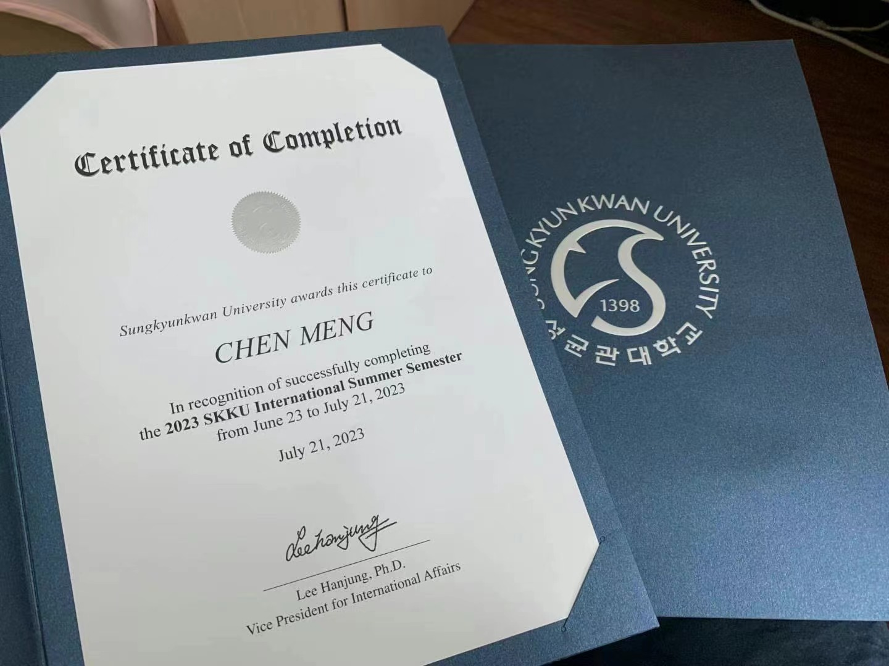
地理位置近
Geographically close
课程时间合理
Reasonable course time
丰富的课程
Rich curriculum
时尚文化
Korean fashion culture

Slide 5
02
衣食住行
Food, clothing, shelter and transportation

Slide 6
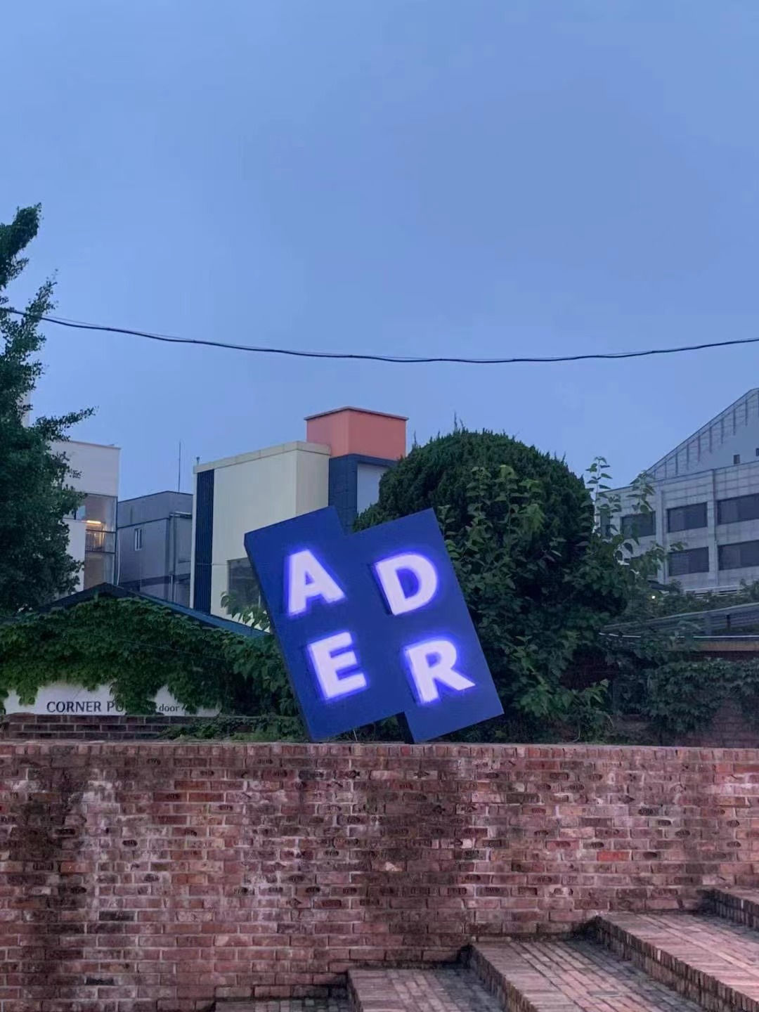
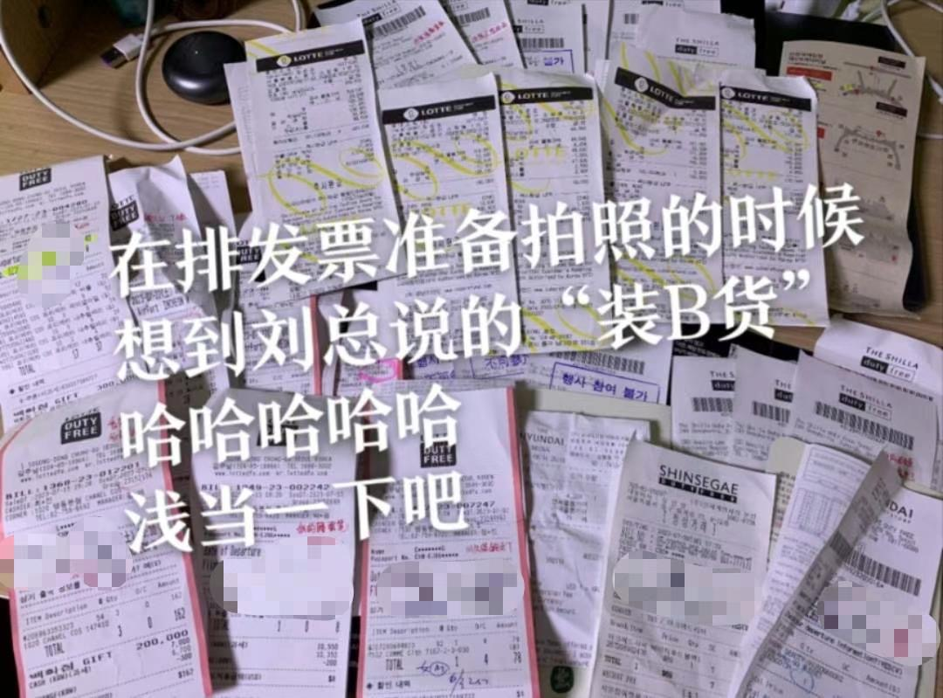
衣在SKKU

Slide 7
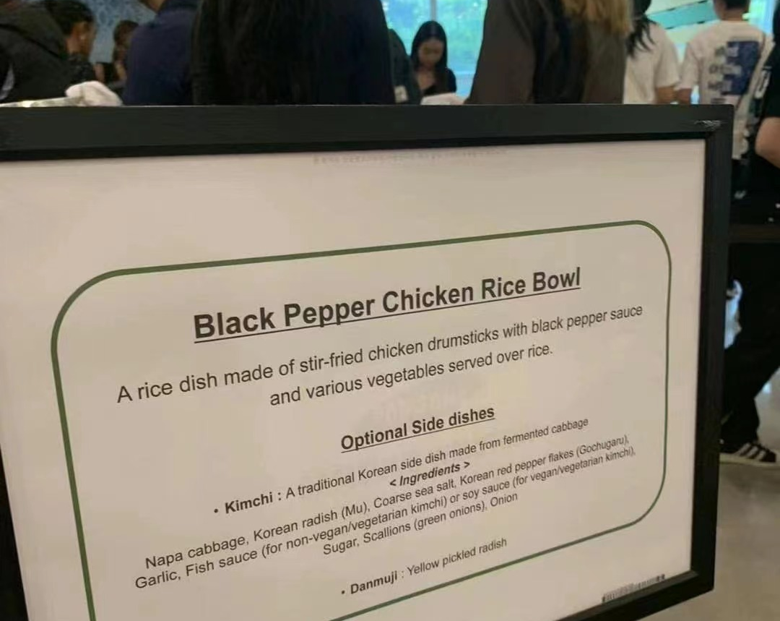
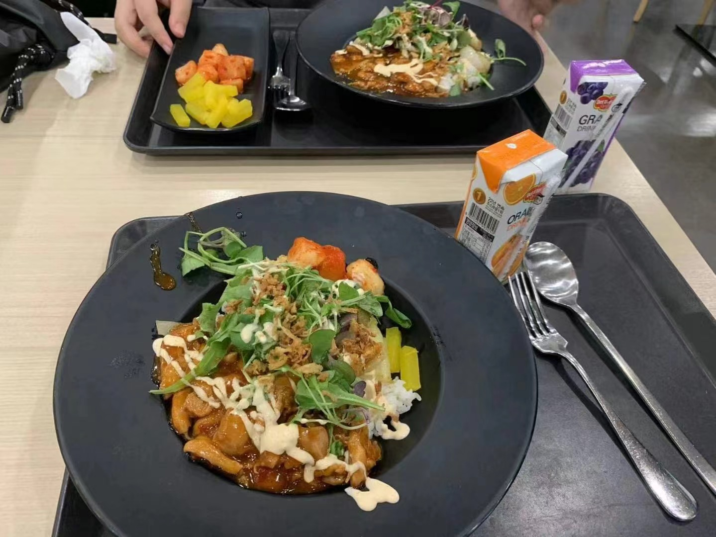
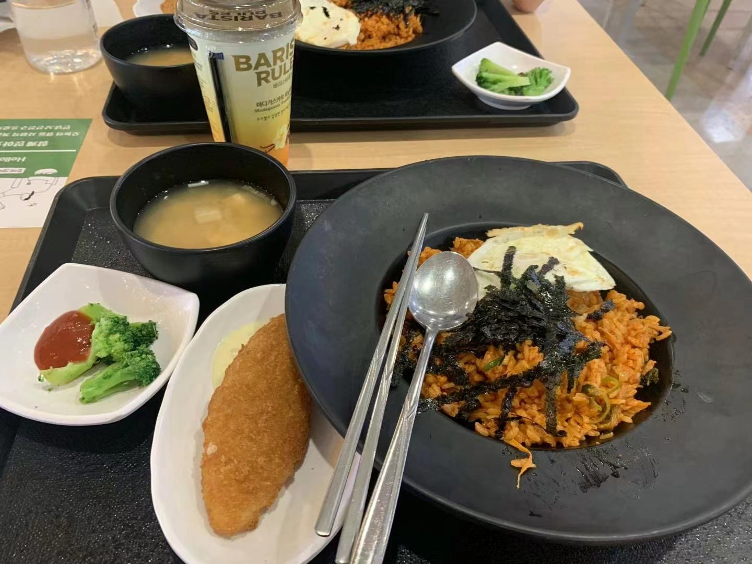
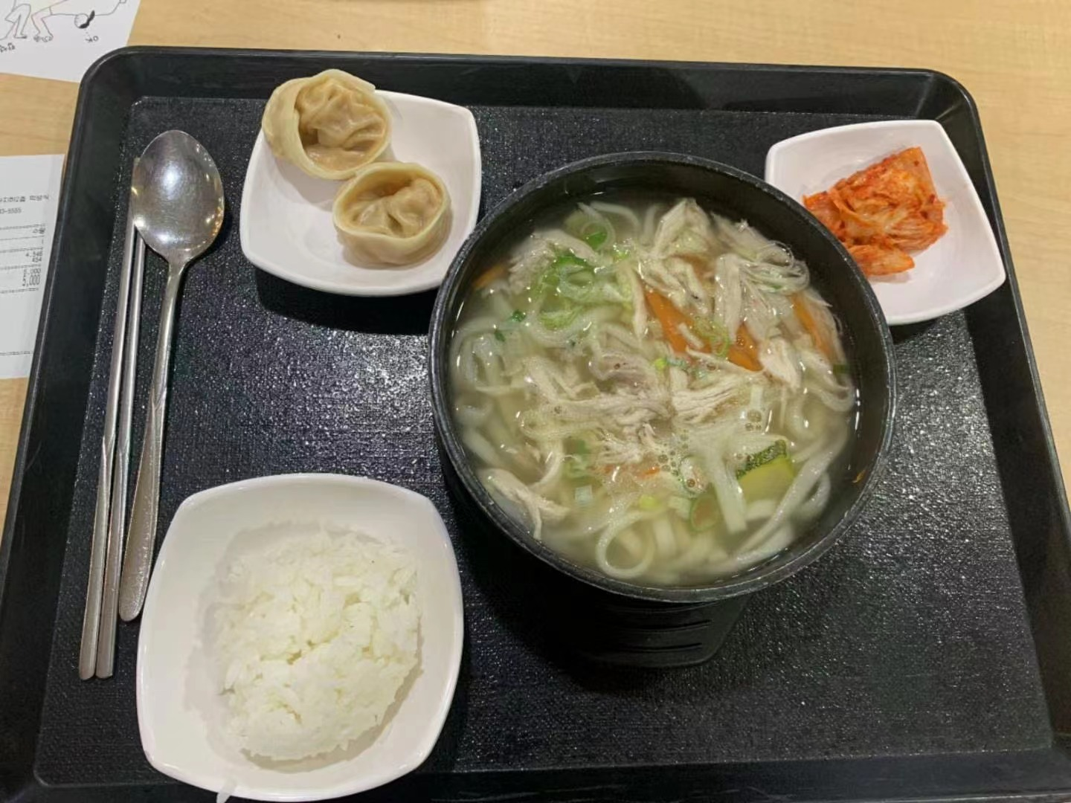
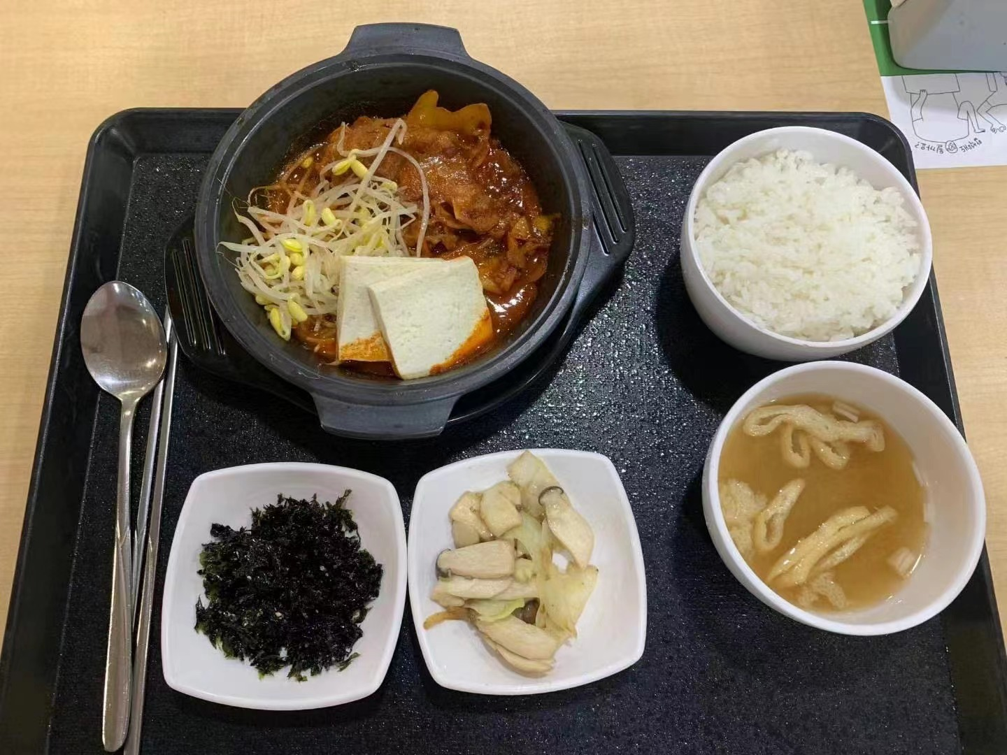
食在SKKU

Slide 8
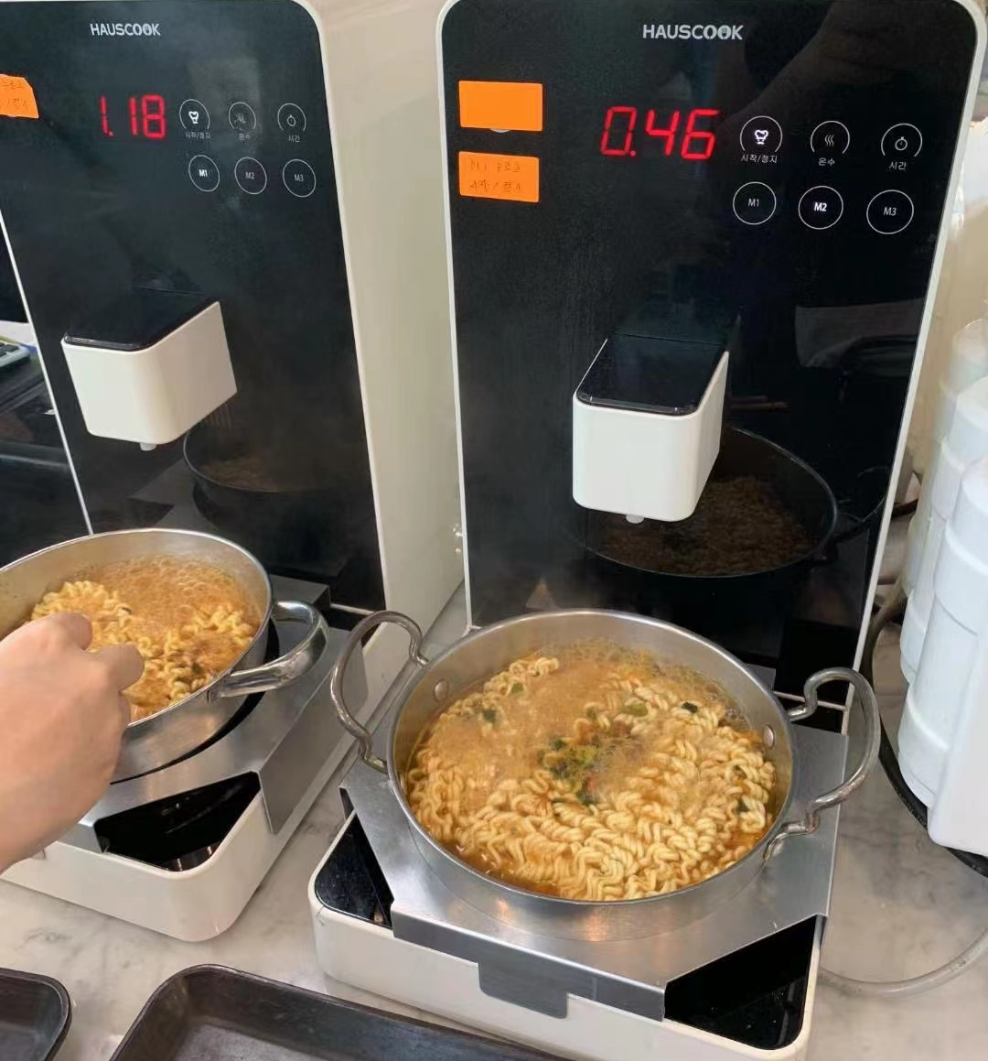
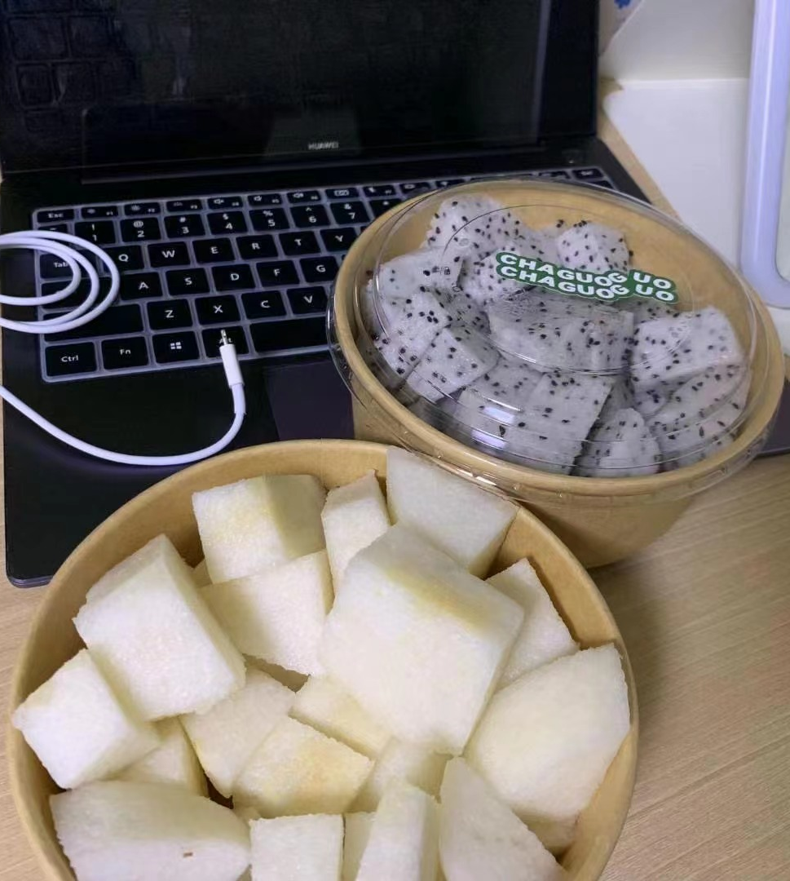
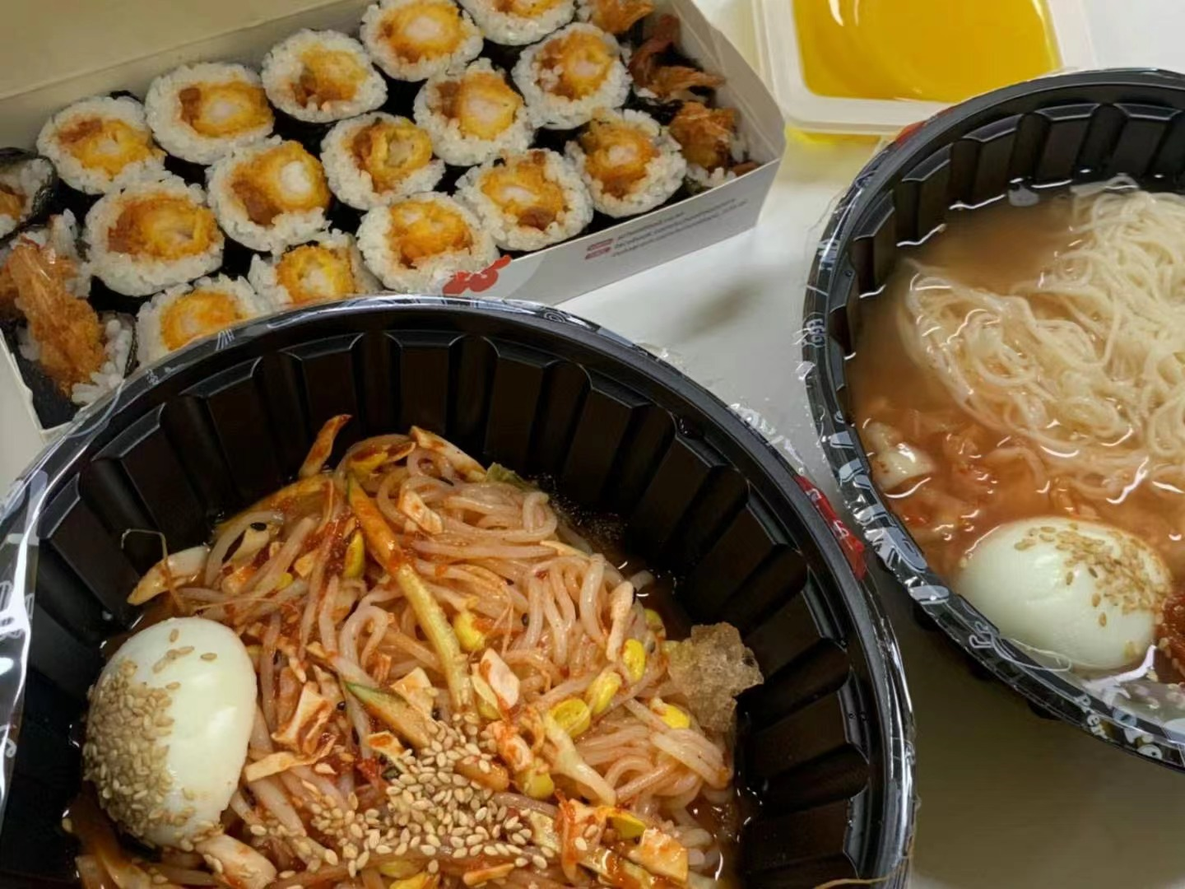
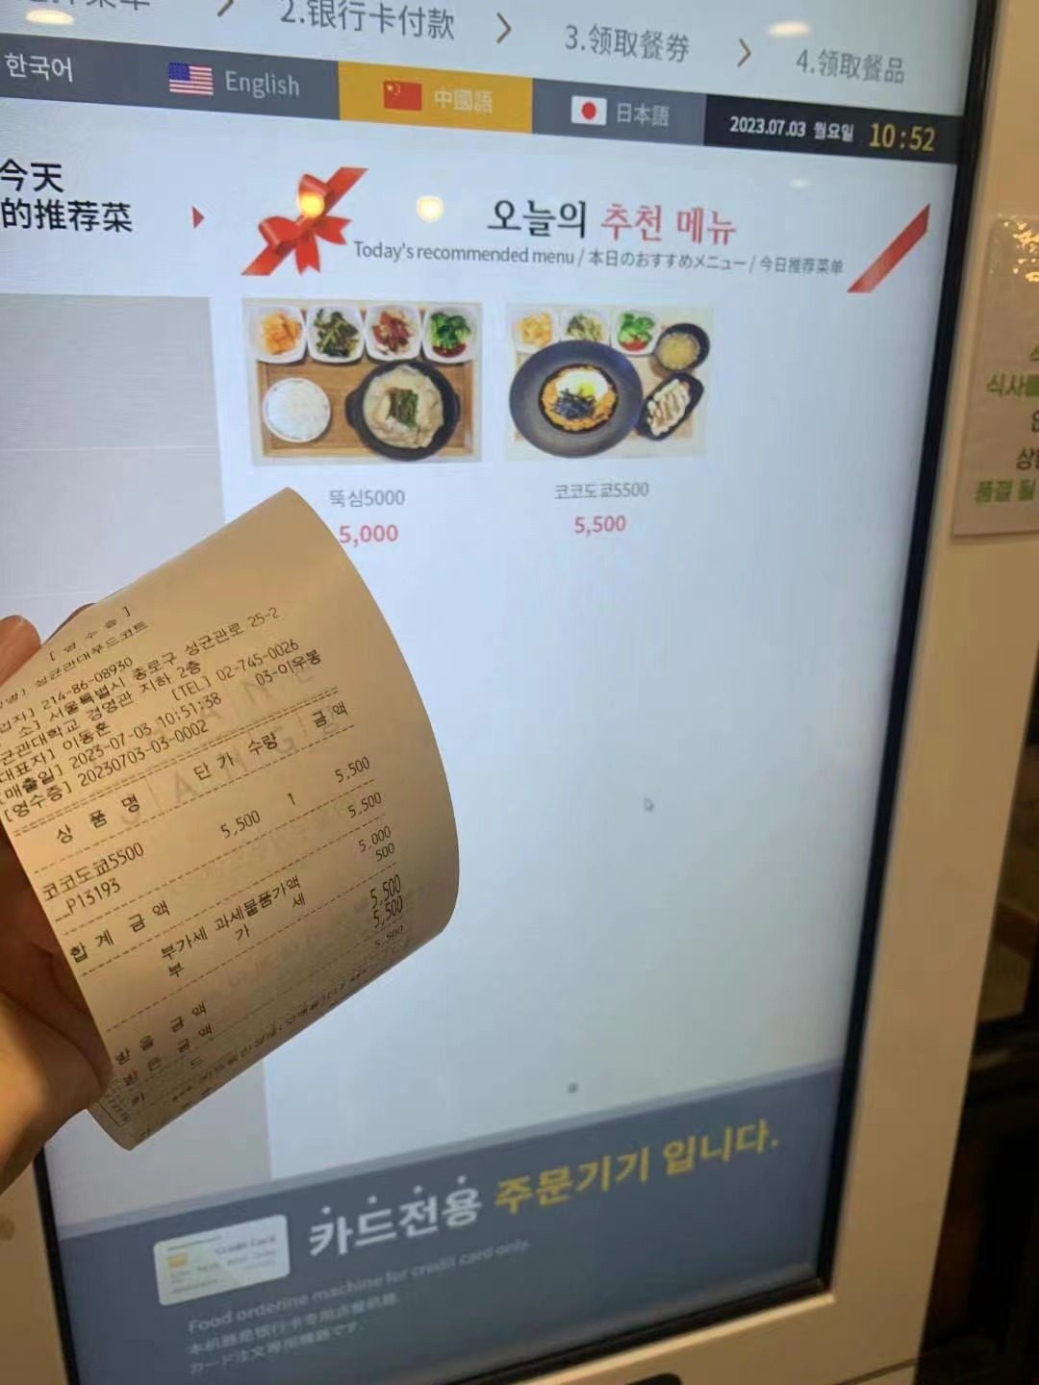
食在SKKU

Slide 9
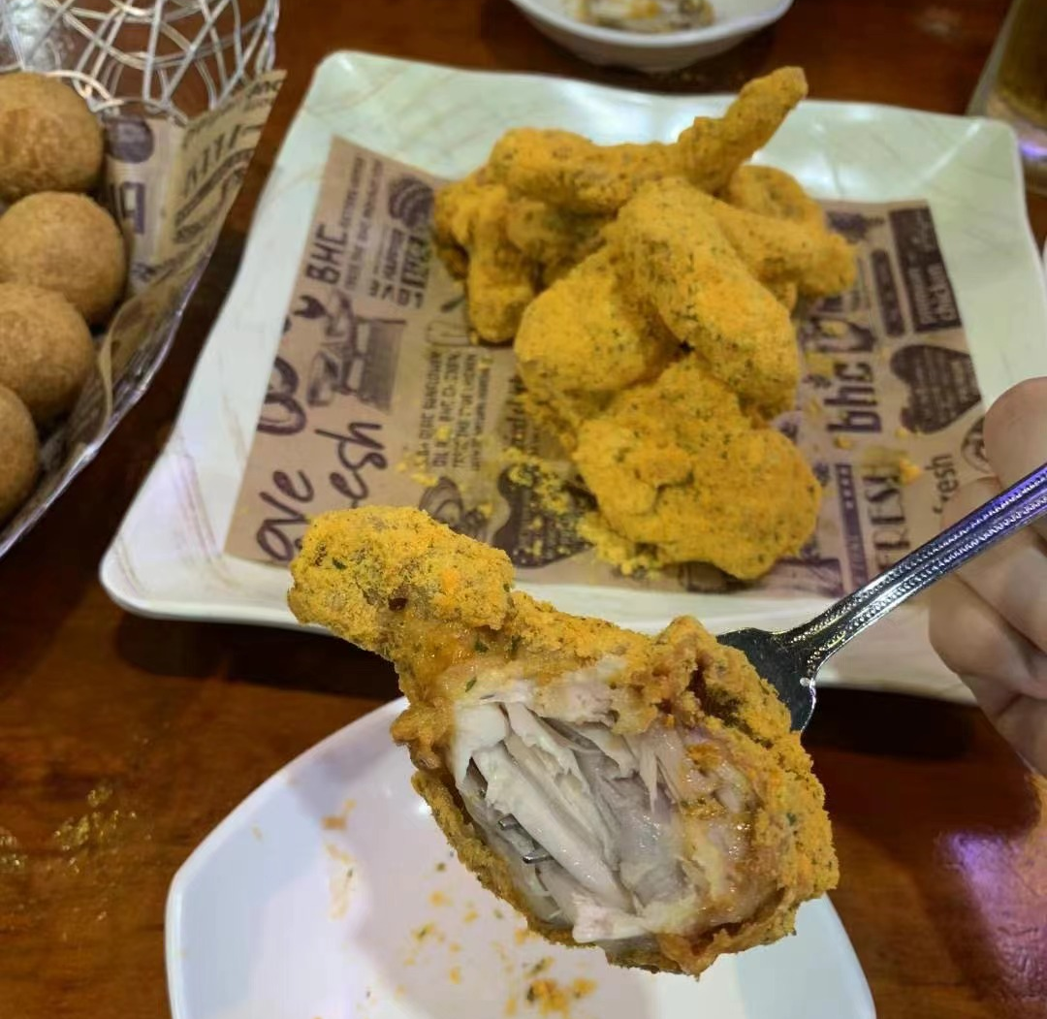
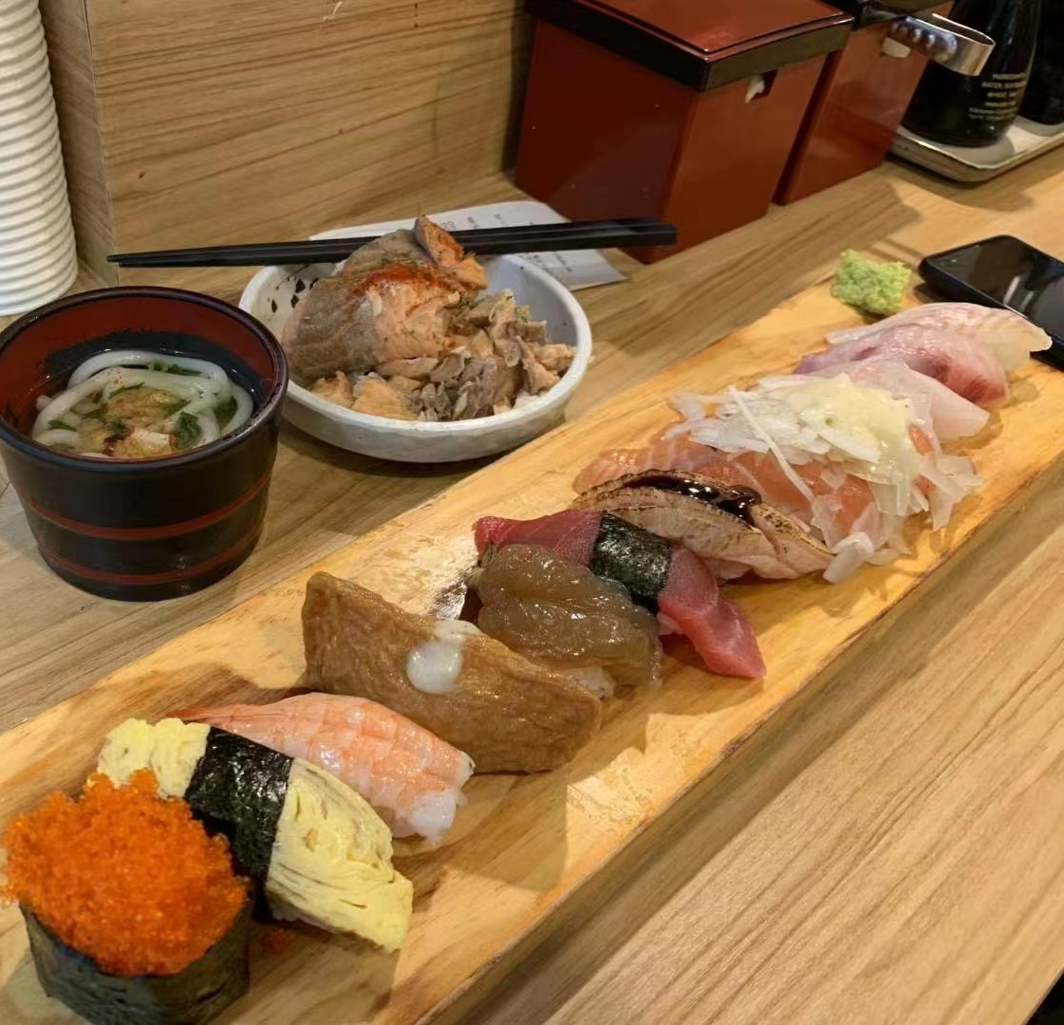
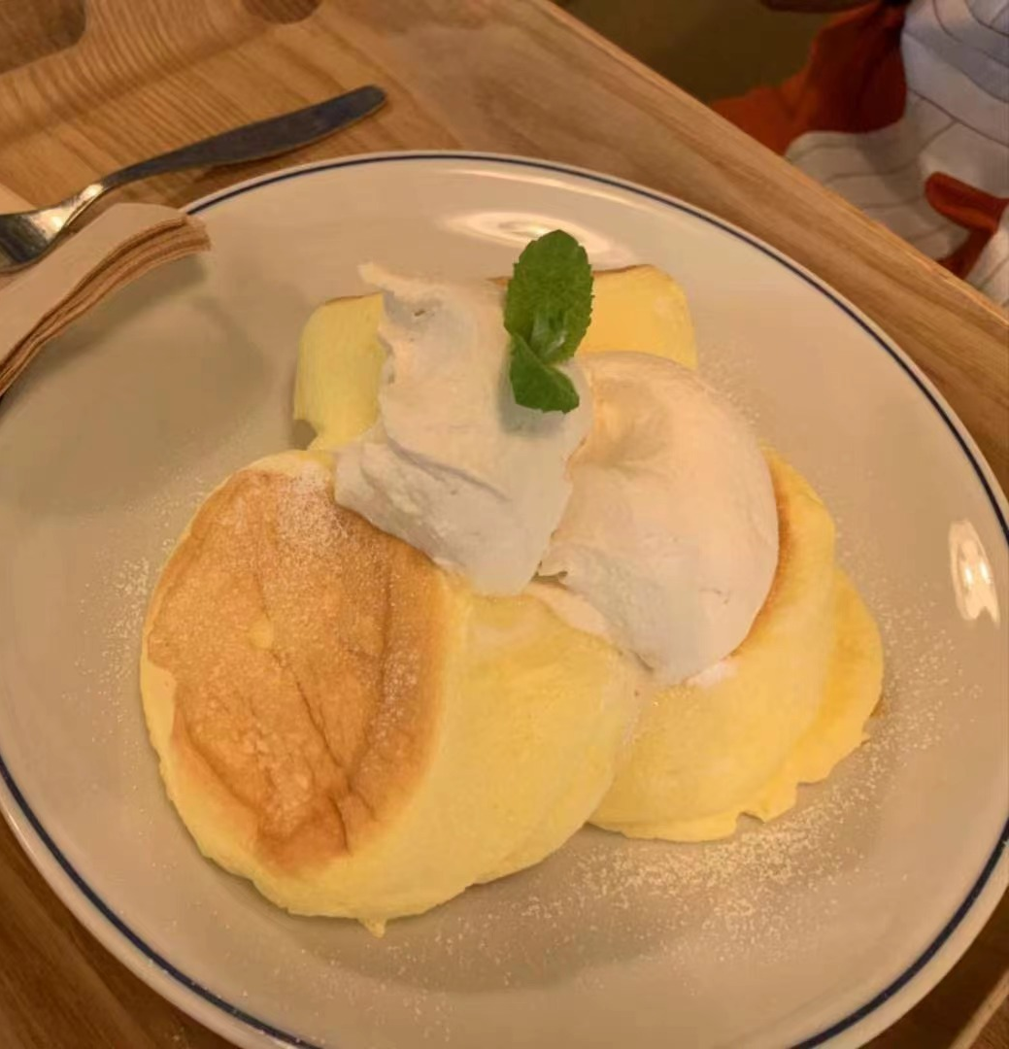
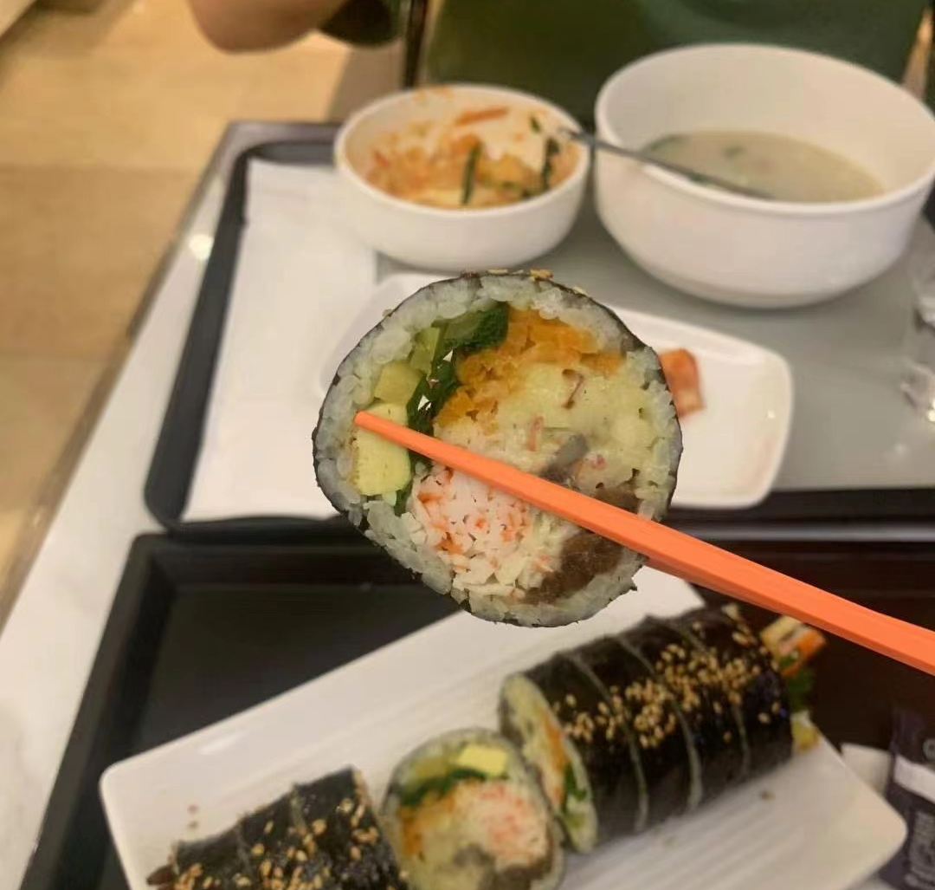
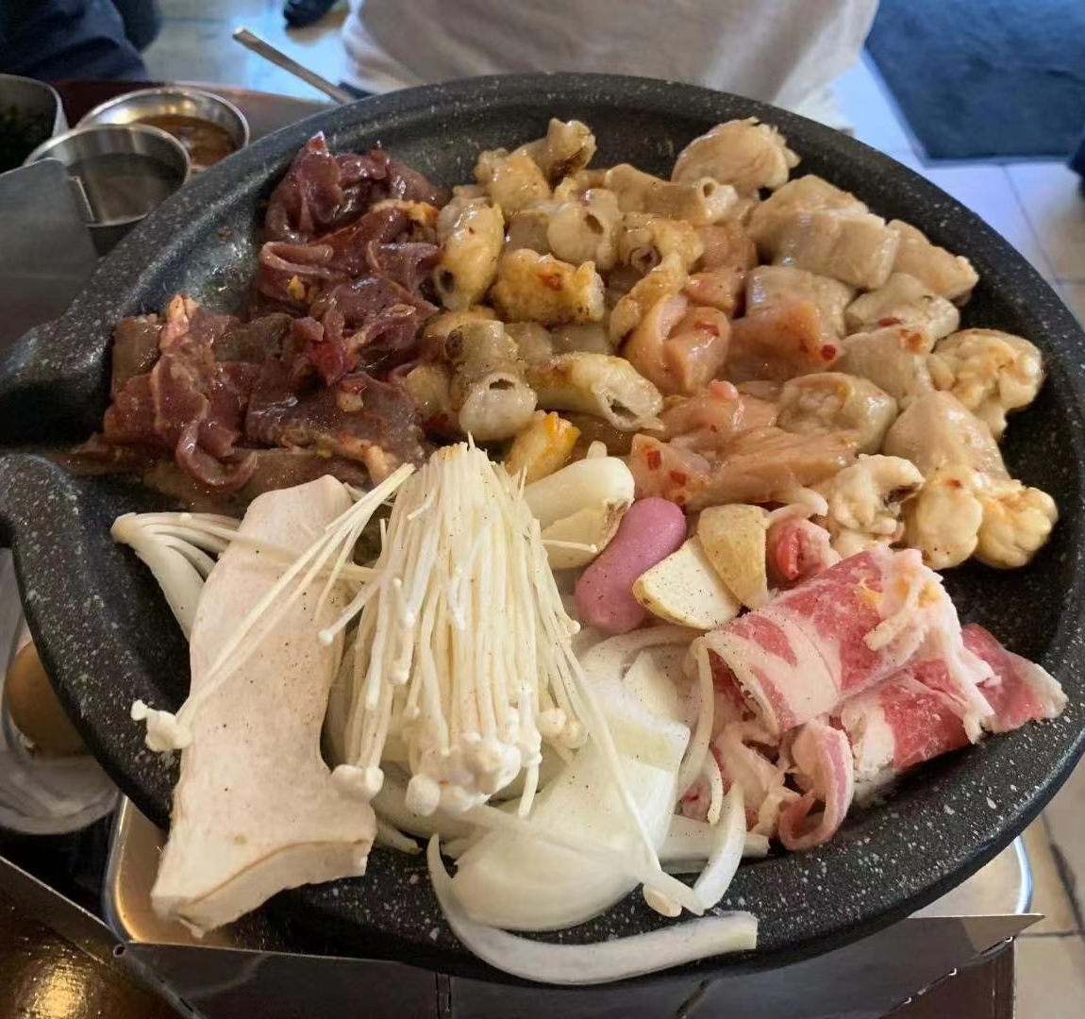
食在Korea

Slide 10
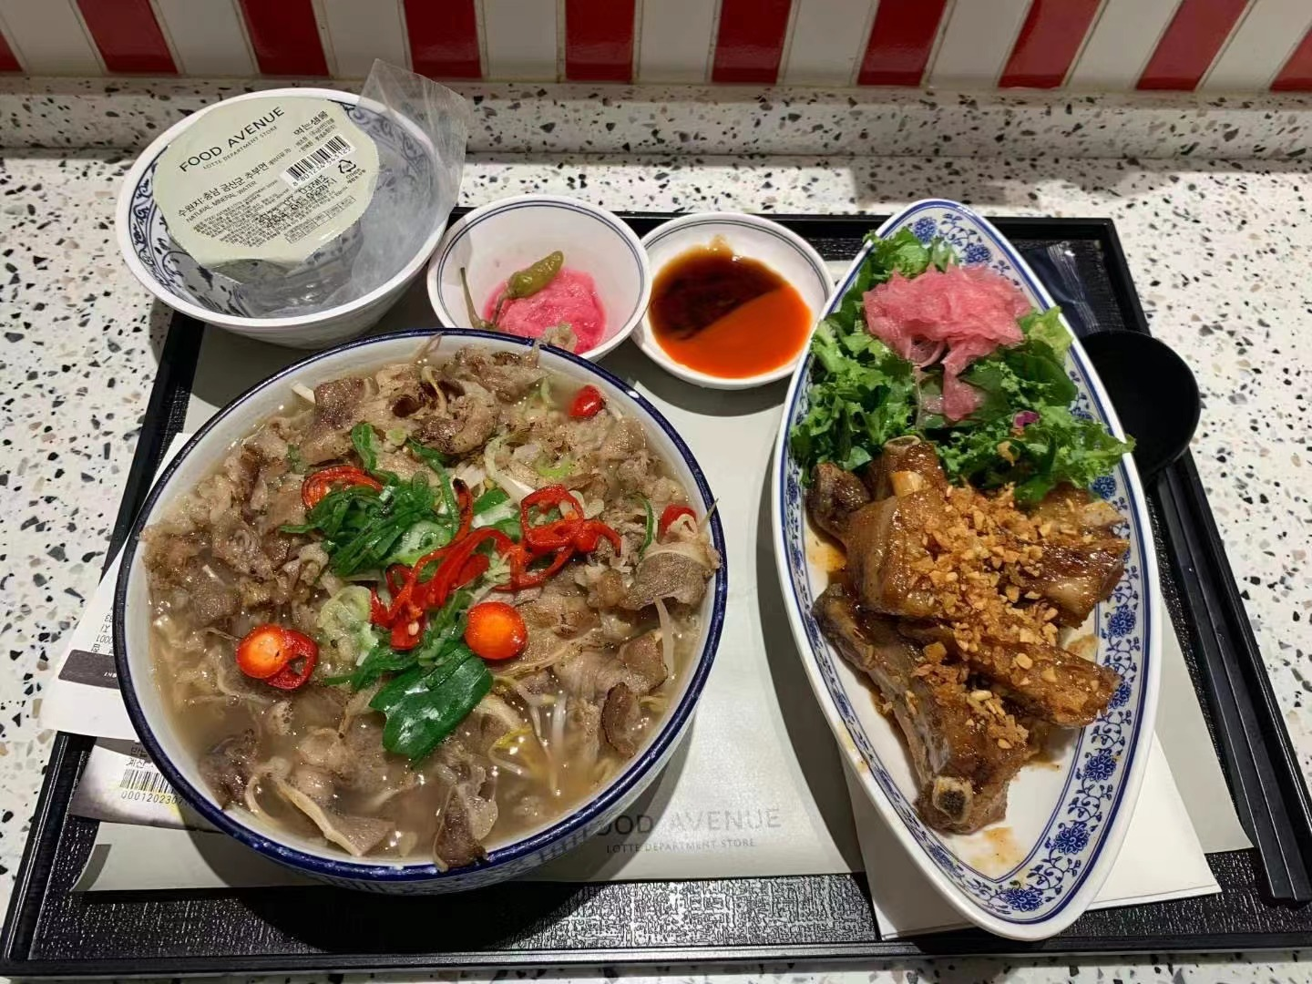
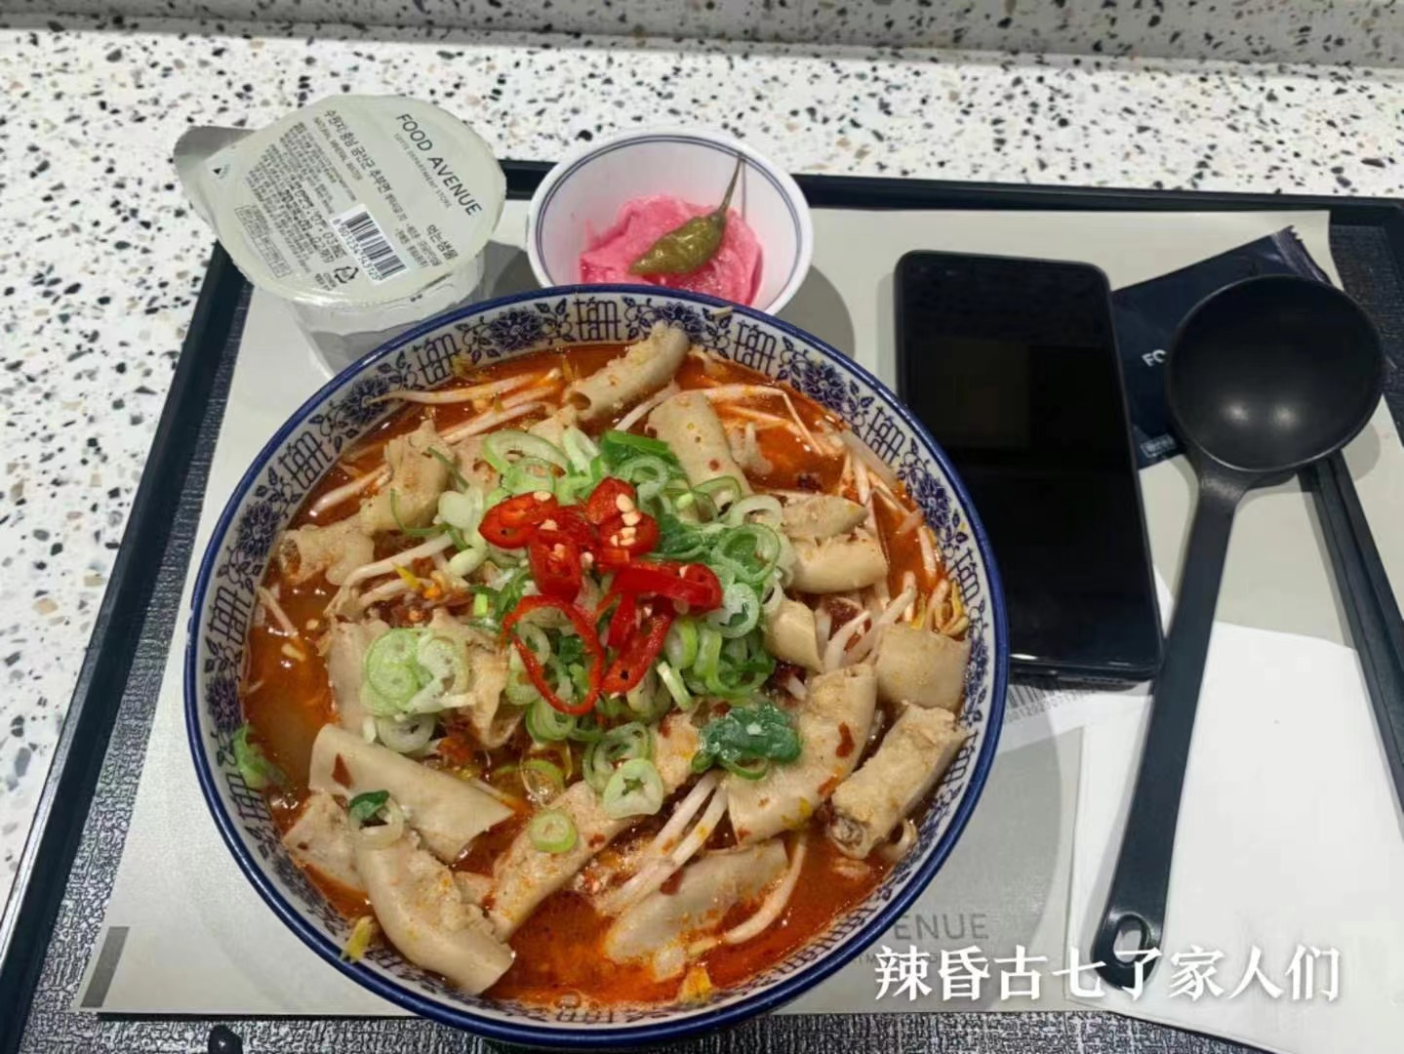
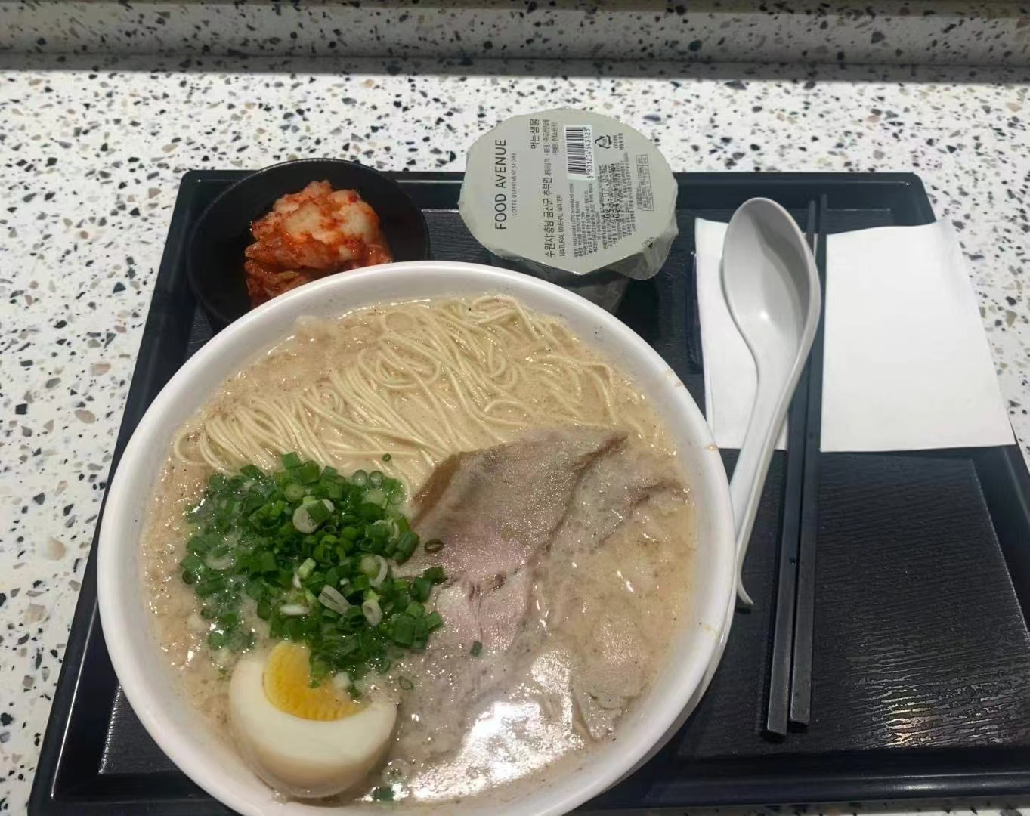
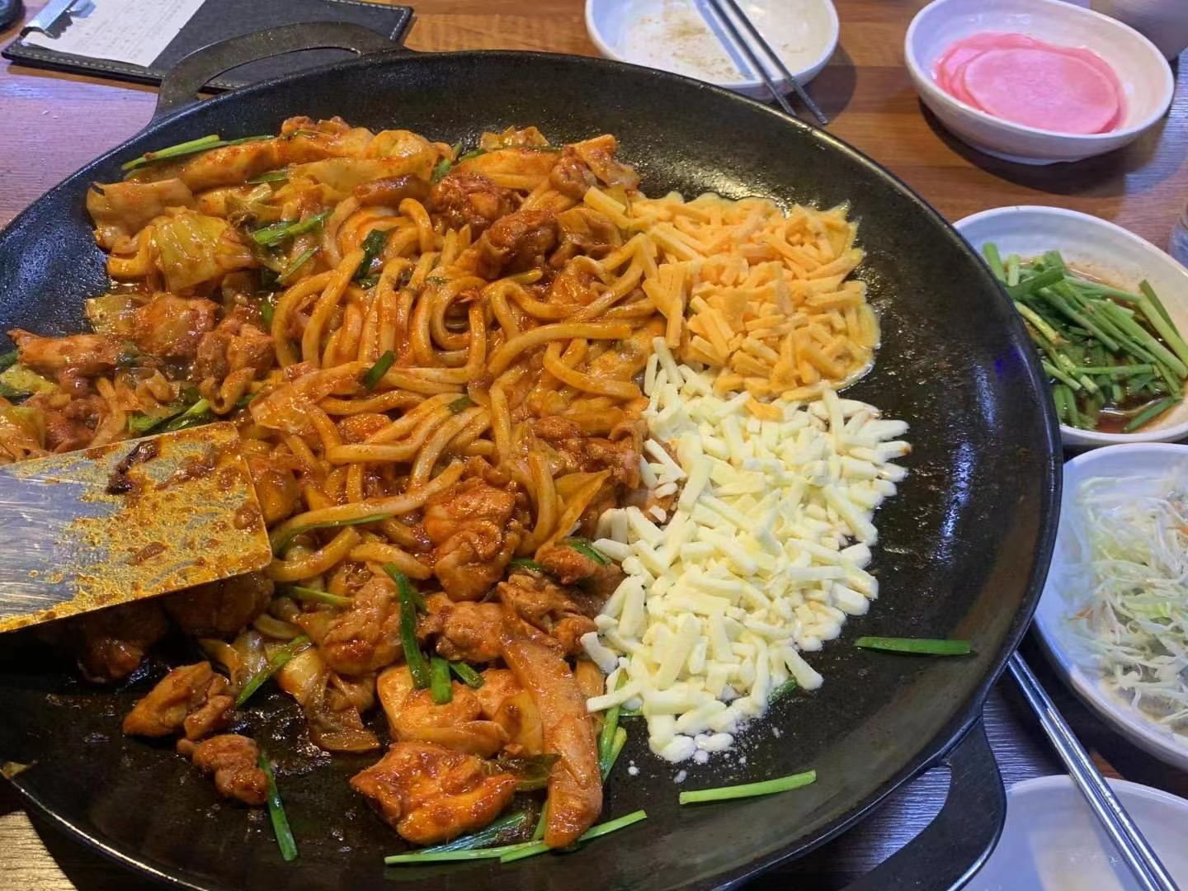
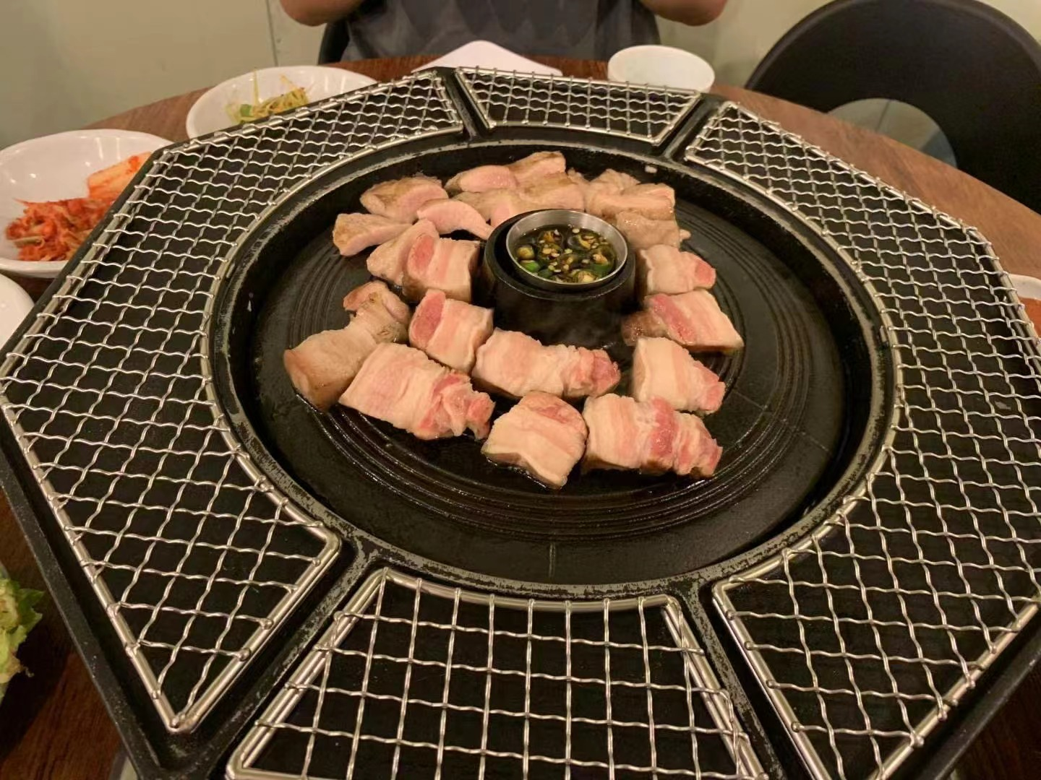
食在Korea

Slide 11
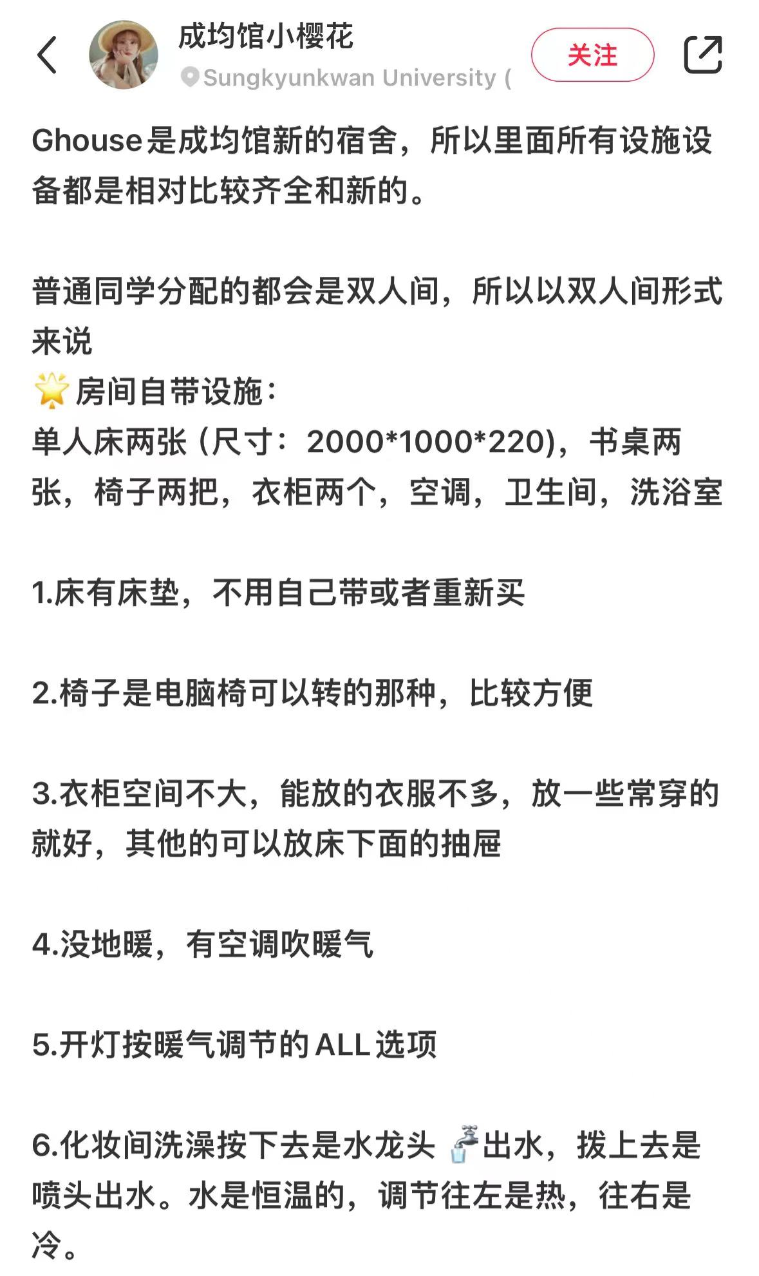
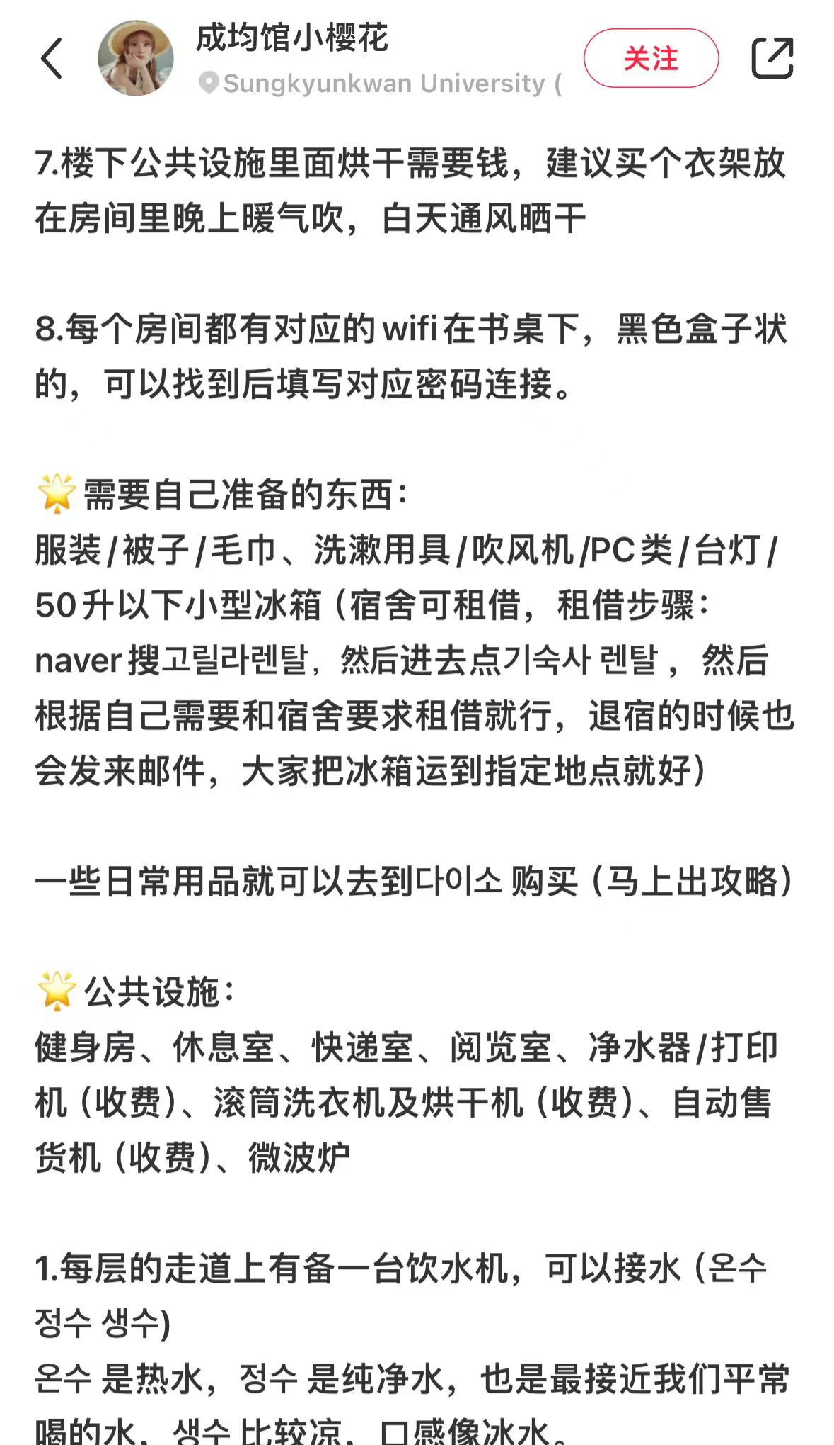
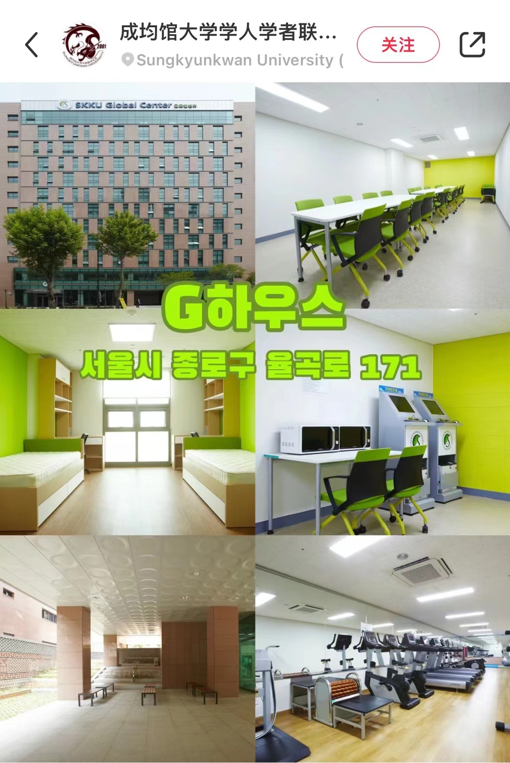
住在SKKU
图文来源：小红书

Slide 12
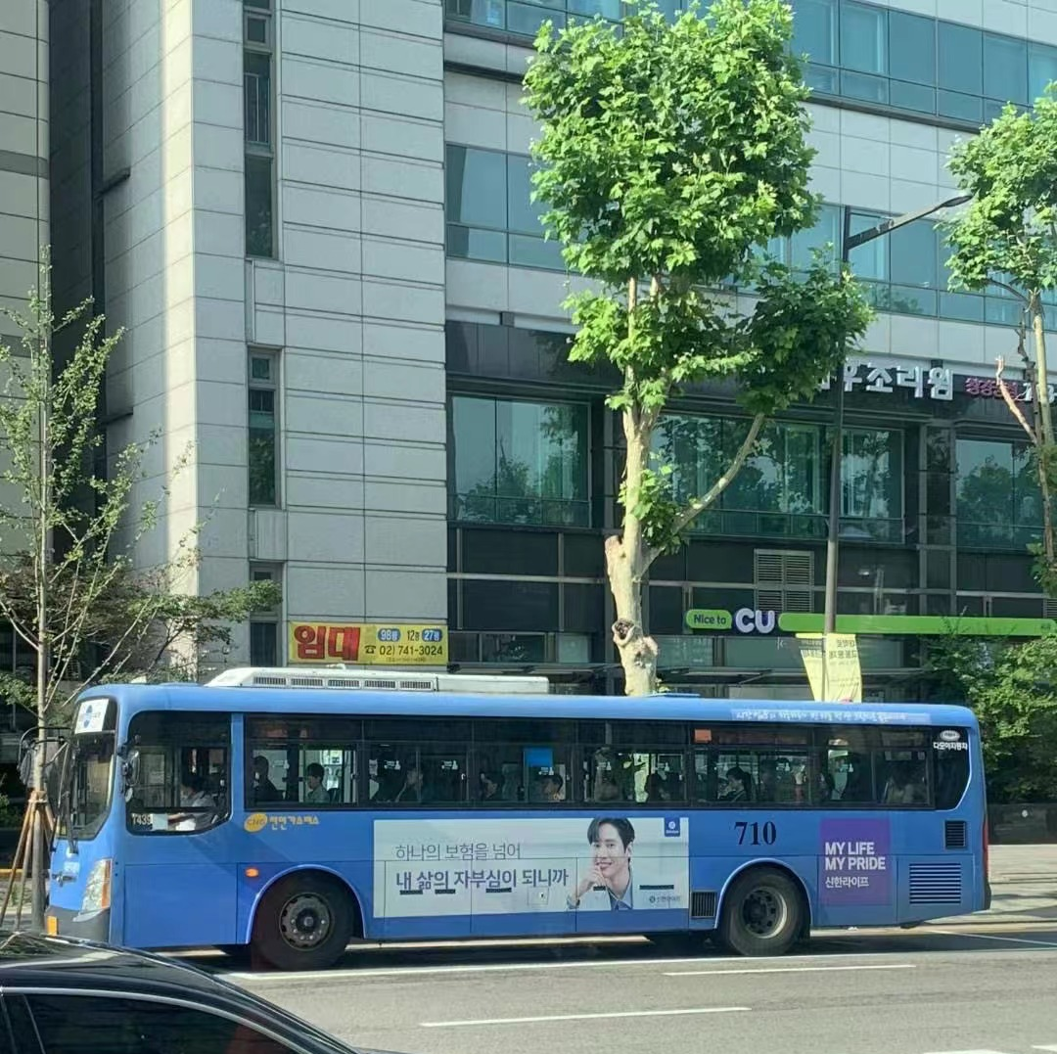
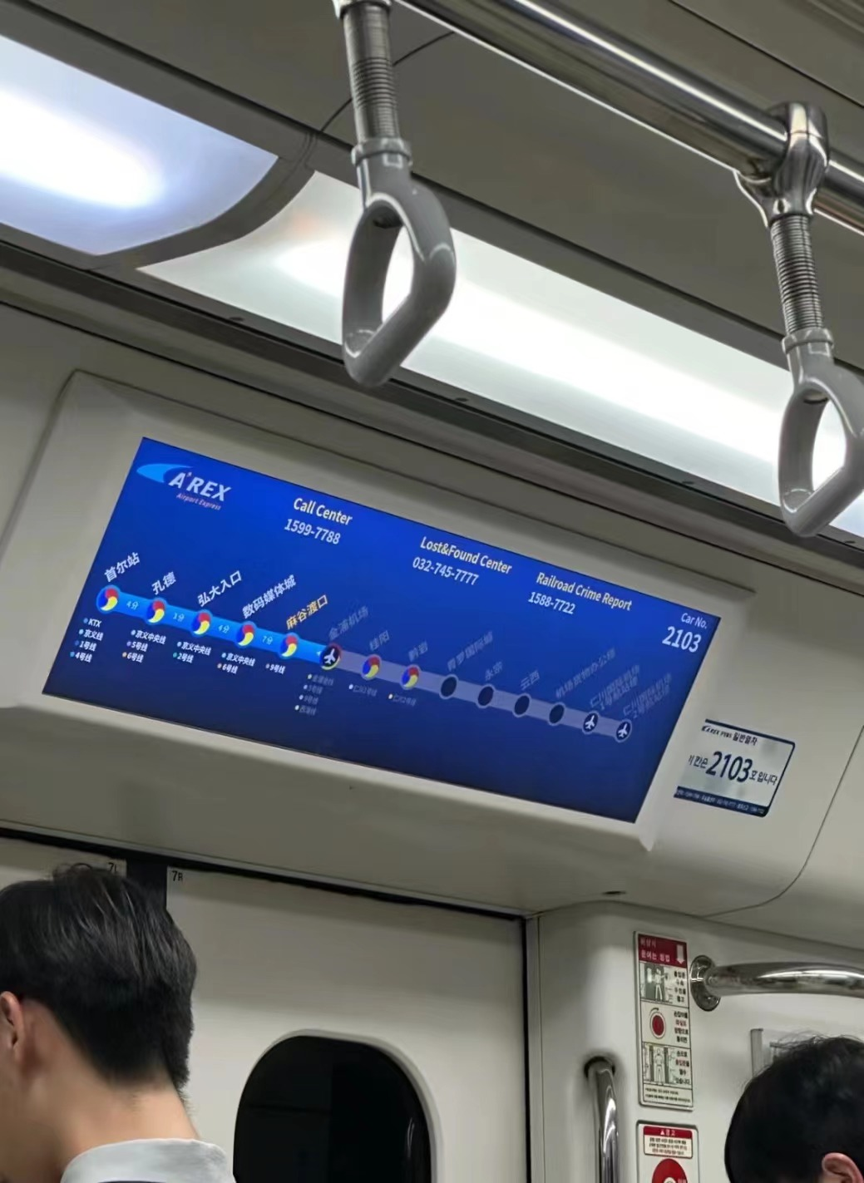
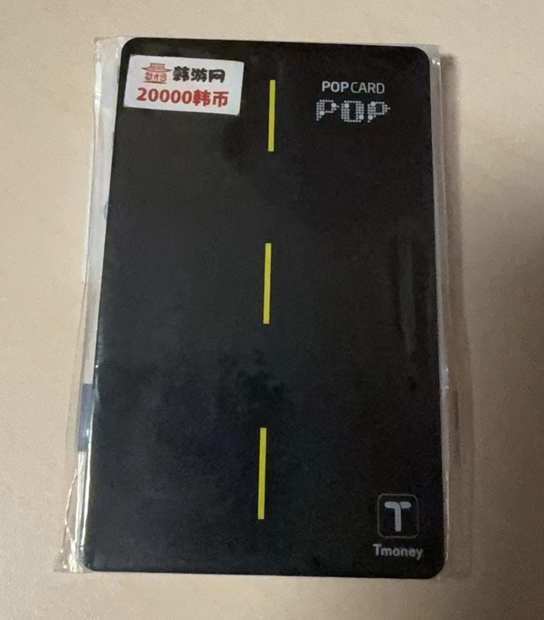
行在SKKU

Slide 13
03
课程体验
Study experience

Slide 14
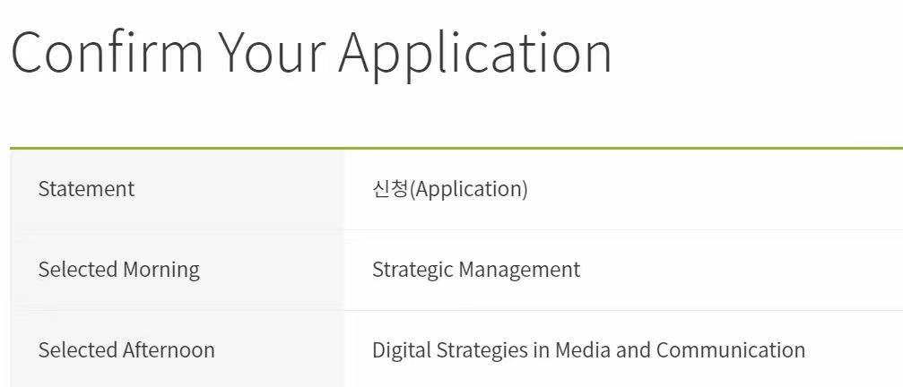
战略管理 Strategic Management
授课内容以案例分析为主，需要参与小组课堂作业，有个人作业和期末考。
Case studies are the main content of the lecture, which requires participation and submission of group class work. There are individual assignments and a final exam.
媒体与传播中的电子战略 Digital Strategies in Media and Communication
授课内容以课堂实践为主，需要在各个平台上学习广告的制作与投放，有个人作业和期末考。
The teaching content is mainly classroom practice, which requires learning advertising production and delivery on various platforms, individual assignments and final exams.

Slide 15

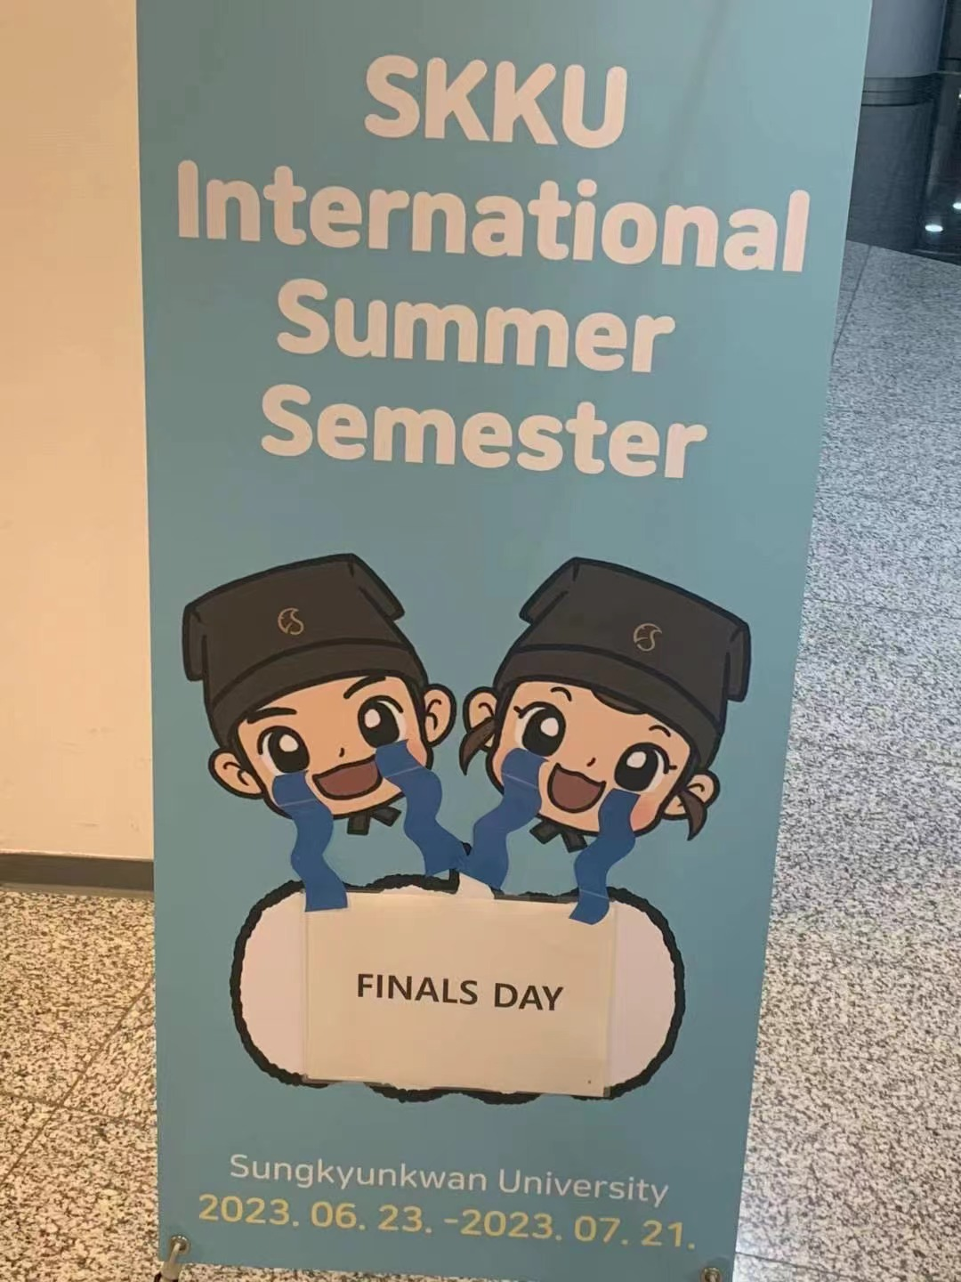
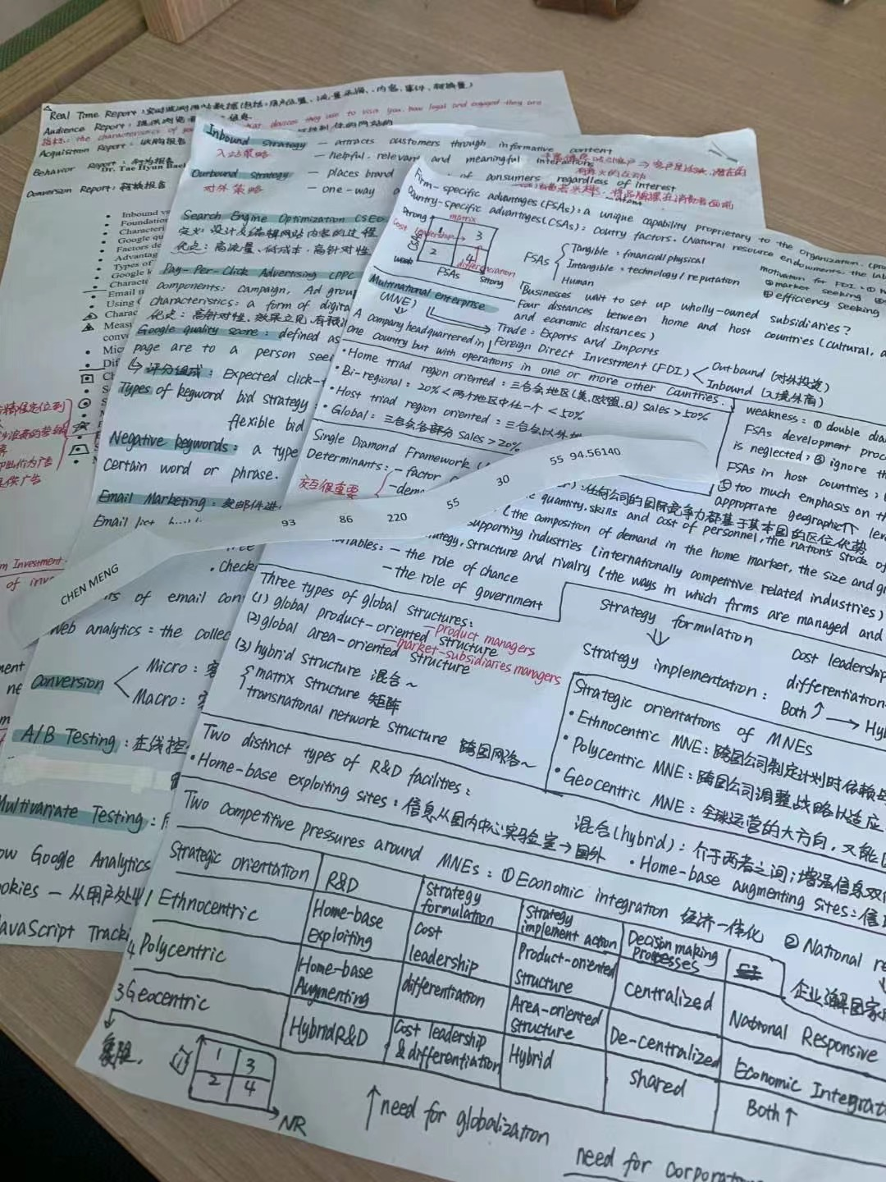
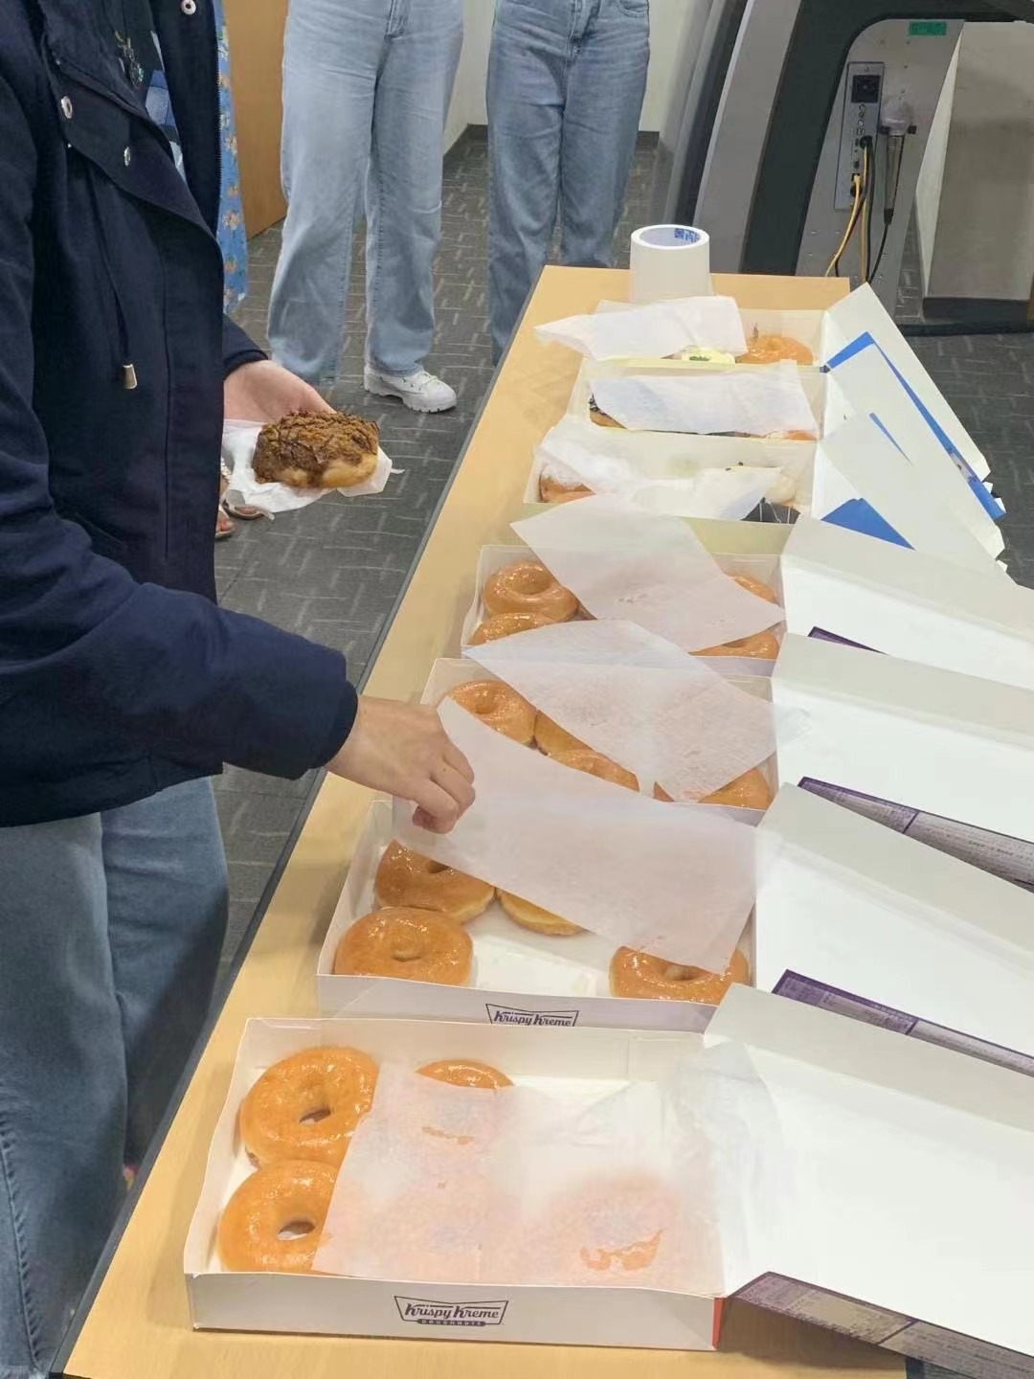

Slide 16
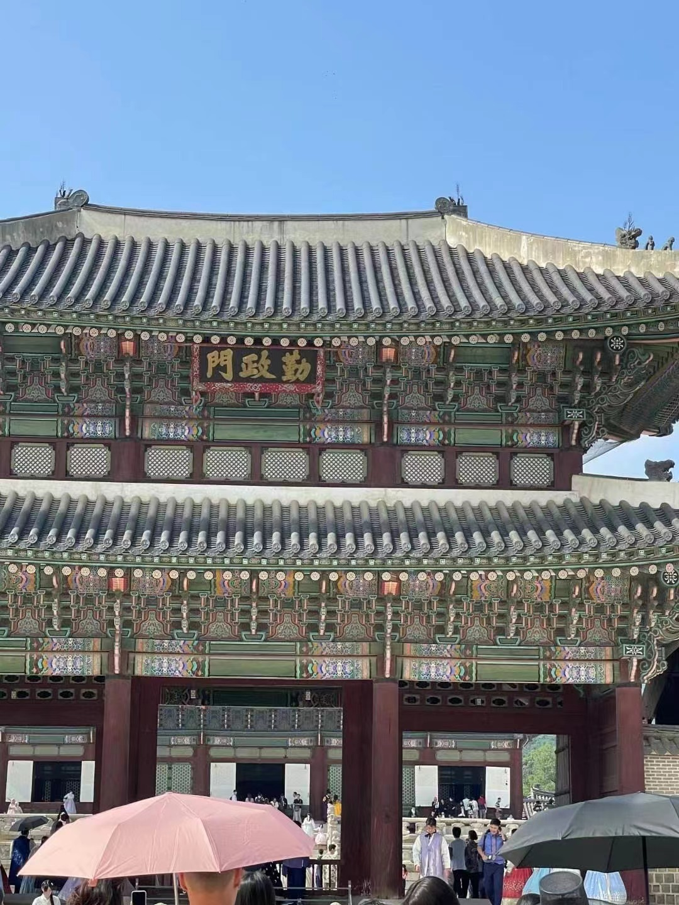
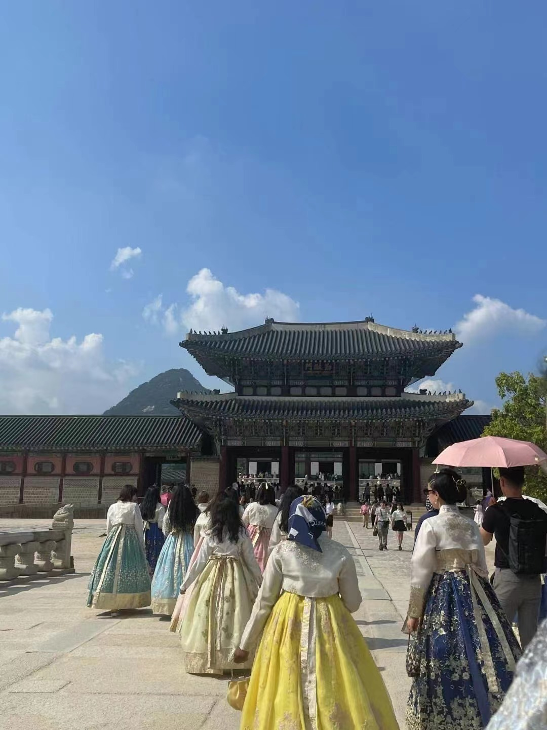
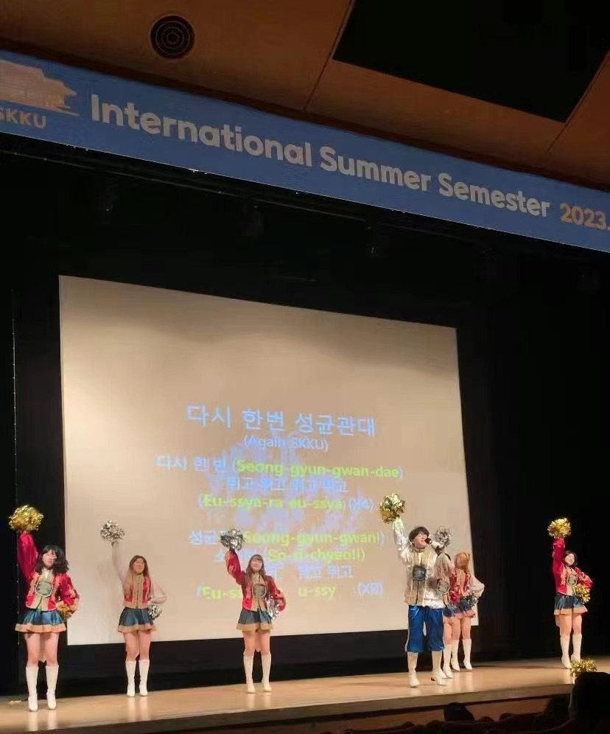
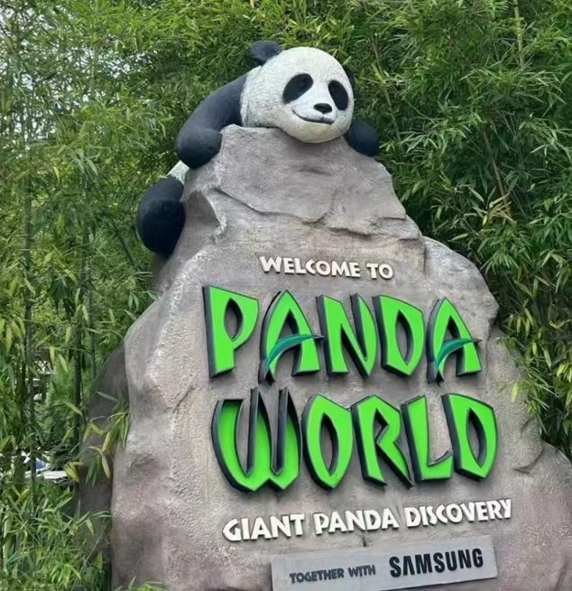
课外文化活动
Extracurricular cultural activities
在为期一个月的暑期课程中，学校组织了多次集体参观活动。
During the one-month summer program, the school organized many group visits.

Slide 17
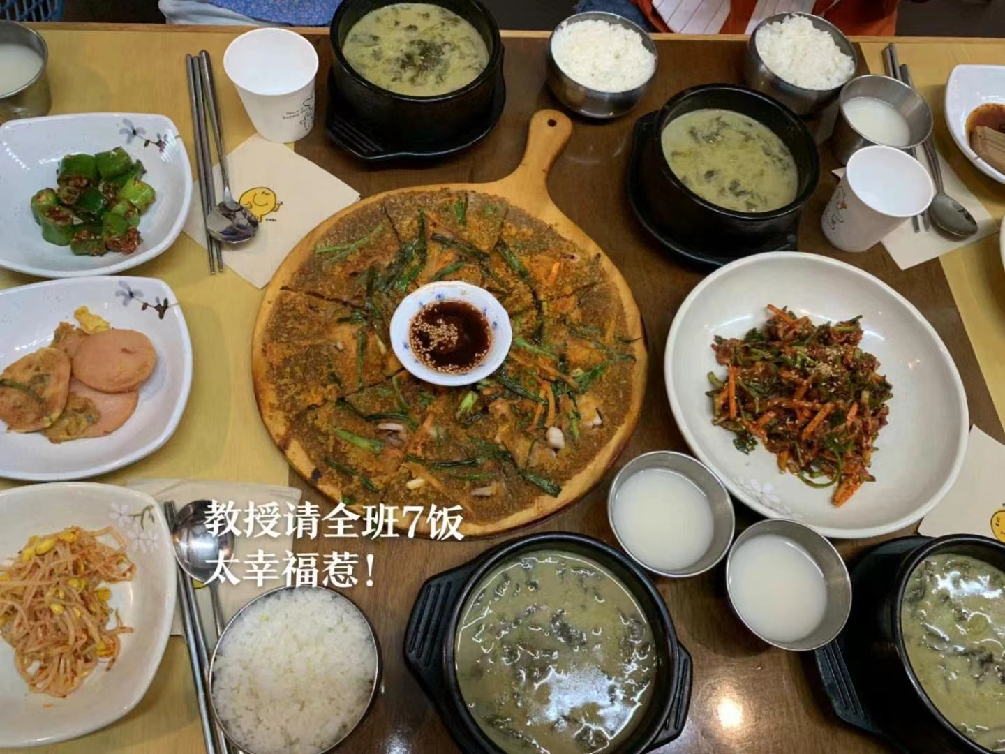
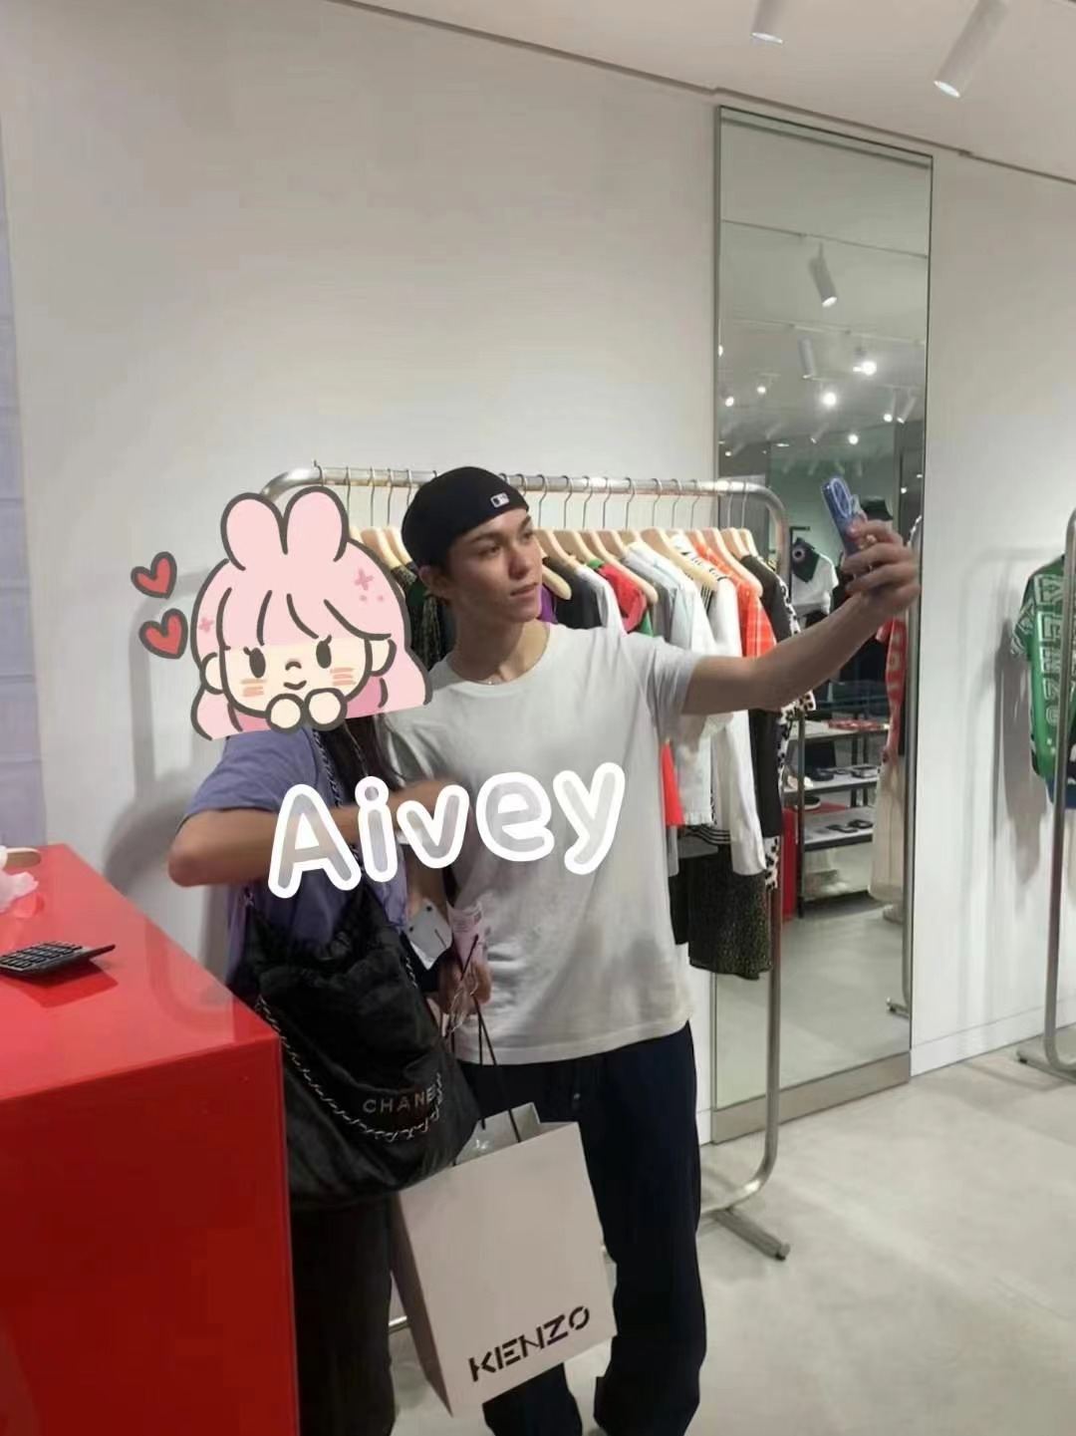
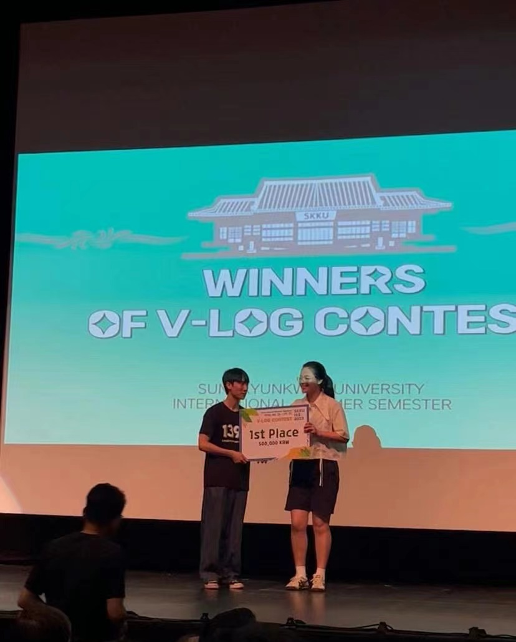
Surprise!!!!

Slide 18
04
感想总结
Summary of feelings

Slide 19
课外活动丰富
不同国家同学
Abundant extracurricular activities
Students from different countries
教授认真负责
购物出行便利
The professors are serious and responsible
Convenient shopping and travel

Slide 20
感谢观赏
Thank you for participation

